Slide 1
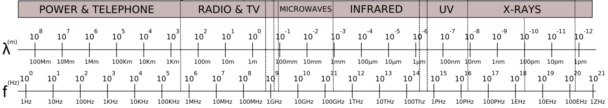
The Electromagnetic Spectrum
You’ll often see this plot flipped, left to right
Visible
Low Energy
High Energy
NMR
MRI
Rotation
Vibrational
Electronic
Ionizing
Bond Breaking
Photon
e⁻
High Energy
Visible
near-IR
mid-IR
Low Energy
Tissue is translucent
350 nm
650 nm
2500 nm
20,000 nm
“wavenumbers” = 1/λ cm⁻¹
4000 cm⁻¹
500 cm⁻¹
Slide 1

Slide 2



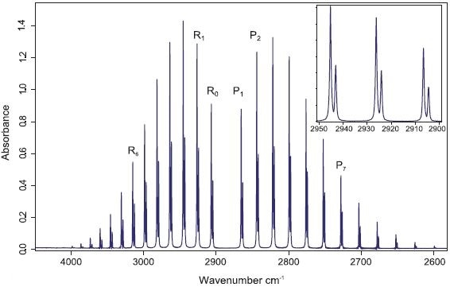
Bond Distance and Vibrational Energy
Standard Bonding Representation
H
Cl
H
Cl
~Harmonic oscillator math
Vibrational energy ➔ IR photons
@ absolute zero all motion stops
H
Cl
H
Cl
H
Cl
Energy
neg 0 pos
Infrared spectrum of HCl gas
Distance
Vibrational quantum levels
Bond
energy
Bond distance
17
35
17
37
Cl
Cl vs
Quantized!
ν = 1/(2π) √k/m
ν : frequency
k: force constant (measure of bond stiffness)
single < double < triple
m: reduced mass – m₁m₂/m₁+m₂
1 / λ (cm⁻¹)
https://www.azom.com/article.aspx?ArticleID=15226
Why start with a gas phase IR spectra???
Slide 2

Slide 3
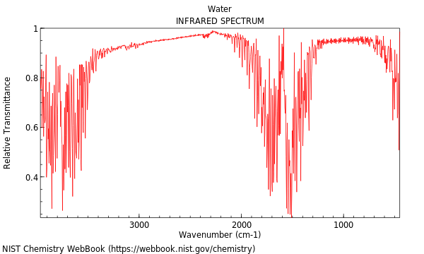
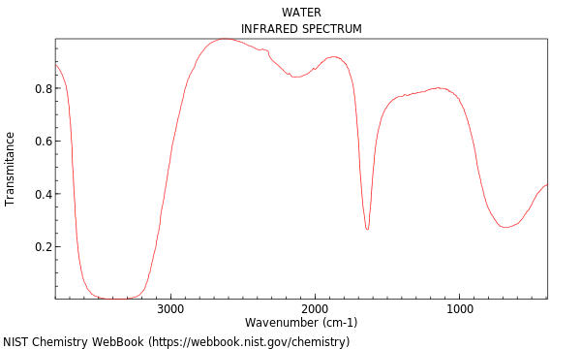
Why P-Chemists Use the Gas Phase:
Ideal Gas Law Assumptions
H₂O gas phase
H₂O liquid phase
Hydrogen bonded H-O
H-O
In the gas phase molecules do not interact (assumption)
pure individual molecular vibrations
In the liquid phase molecules are touching
molecular vibrations are modified (change in energy) by interactions with neighboring molecules
In water the highest energy intermolecular interaction is????
Slide 3

Slide 4
What Determines Which Molecules
Absorb Infrared Energy?
H₂, N₂, O₂ do not absorb infrared energy
And CO₂, H₂O and CH₄ all absorb IR?
Why?
Absorbing an IR photon must change the atomic positions in a way that results in a change in the molecular dipole moment
H₂, N₂, O₂ cannot have a dipole
Water does ….
All greenhouse gases!!
H H
O
H H
O
H H
O
H H
O
H H
O
Rocking 1
H H
O
Stretching
symmetric
Bending
In-plane scissoring
Stretching
asymmetric
Twisting
Rocking 2
Or simultaneous combinations of the above
Slide 4

Slide 5
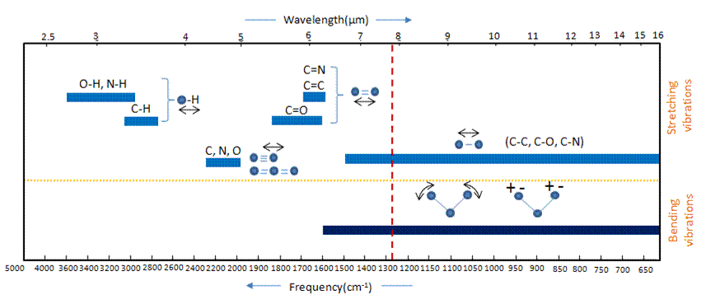
IR Assignment Rules
Actually More Guidelines Than Rules
Fingerprint region – difficult to make individual peak assignments but useful if you have a reference spectra for comparison
Group Region – useful for identifying functional groups
C C
C N
High Energy
Low Energy
http://opening.download/spring-opening.html
Slide 5

Slide 6
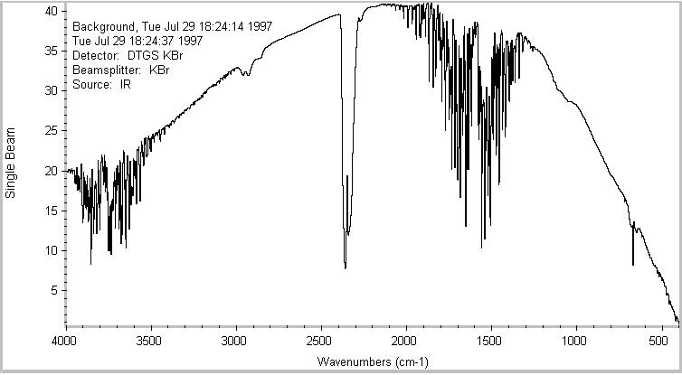
Single Beam IR with No
Background Subtraction
Source and detector variation with wavelength
H₂O vapor
H₂O vapor
CO₂ gas
Slide 6

Slide 7
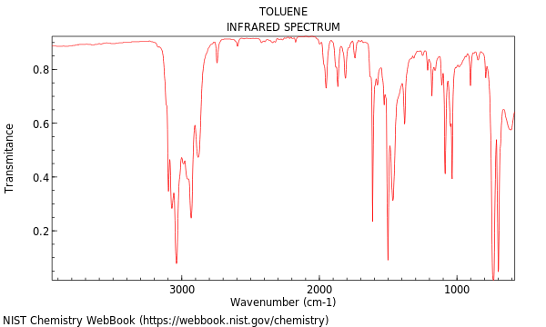
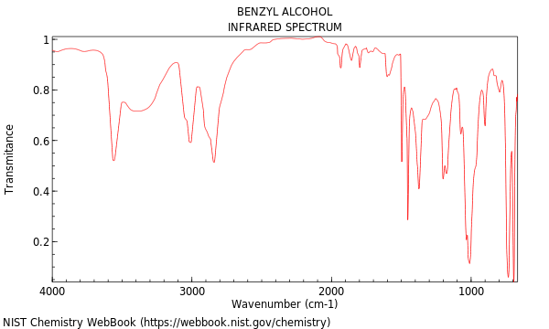
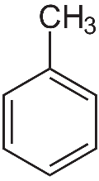
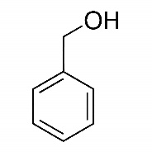
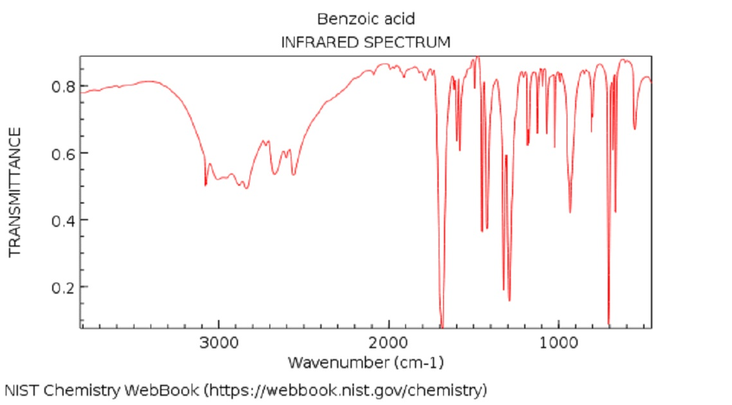
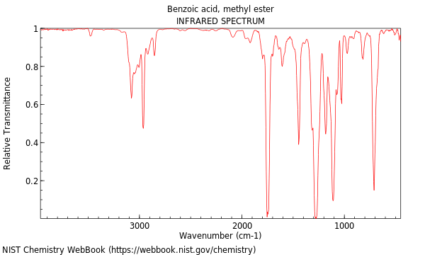
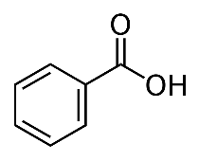
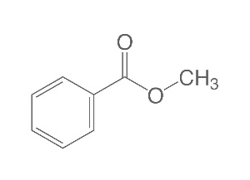
A Series of Benzene Derivative
IR Spectra
H-O
C=C
=C-H
C=C
-C-H
>3000
=C-H
-C-H
<3000
H-O
C=O
=C-H
C=O
C=C
Slide 7

Slide 8
Building a Spectrophotometer
In the UV/Visible region wavelength selection is accomplished with a monochrometer
Sample Cuvette
Monochromator
Broad Band White Light Source
Dispersed Into Discreet Wavelengths
Photomultiplier (PMT) or
Silicon Photodiode Detector
Slit Isolates Desired Wavelength
The original “dispersive” IRs had a reasonable similar design
And then came the Michelson Interferometer ……
Slide 8

Slide 9
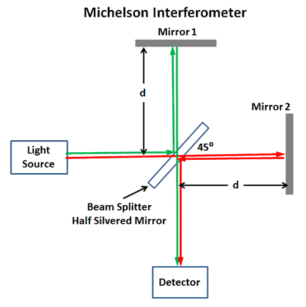
A Michelson Interferometer Uses Constructive/Destructive Interference
d₁ = d₂
Constructive interference
d₁
What happens if we start moving one of the mirrors?
d₂
d₁ = d₂ - ½ λ
Destructive interference
https://www.mpoweruk.com/figs/Michelson-Interferometer.htm
Shift ½ wavelength
The frequency (cycles/s) of the switch between constructive/destructive
= mirror velocity * 1/λ
The Laser Interferometer Gravitational-Wave Observatory (LIGO) uses an interferometer that is 4 kilometers long to detect gravitational waves
Slide 9

Slide 10
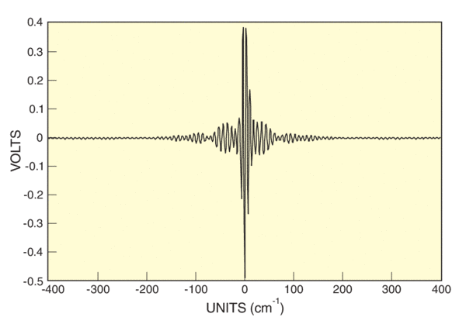
The Interferogram:
All Wavelengths Simultaneously
λ₁
Each wavelength alternates between constructive & destructive interference
But in a different time sequence
λ₁ & λ₂
An Interferogram is the result
What the detector sees
λ₁ + λ₂
https://www.newport.com/n/introduction-to-ftir-spectroscopy
Slide 10

Slide 11
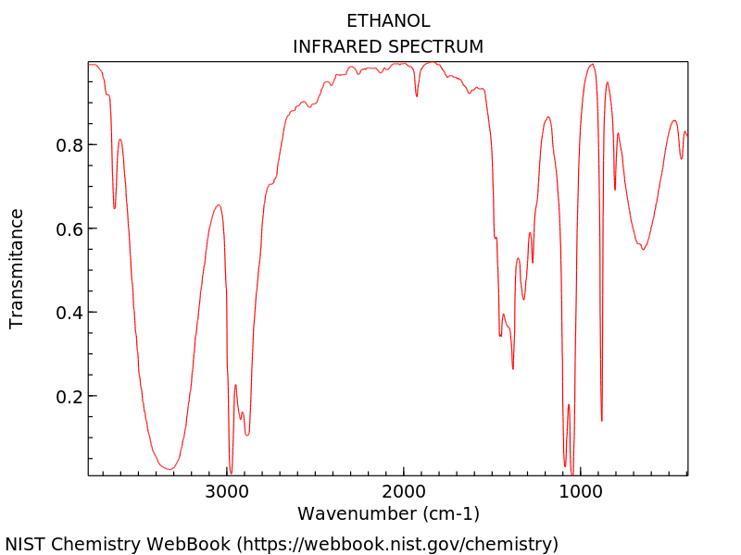

Interferogram is Time Domain
Spectra is Frequency Domain
➔
https://www.newport.com/n/introduction-to-ftir-spectroscopy
How do we get from an Interferogram in the time domain
To a spectra in the frequency domain?
Fourier transform math
f(frequency) = f(time)
∞
+
∫
−i2πνt
f(ν) = f(t)e dt
∞
-
Slide 11

Slide 12
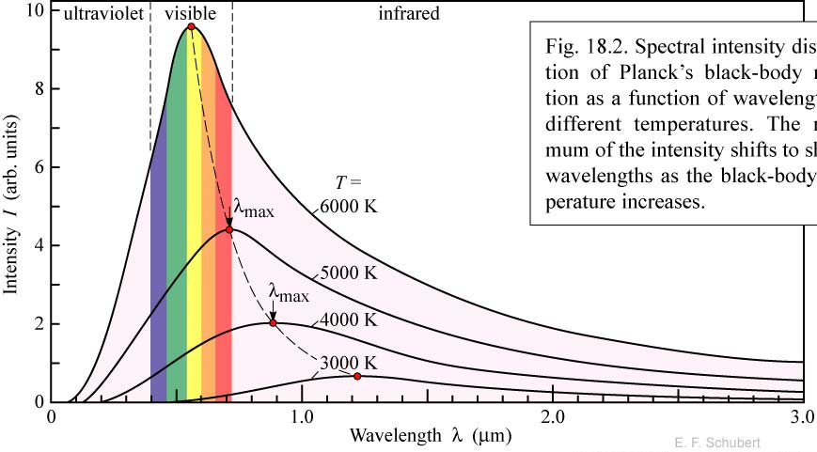
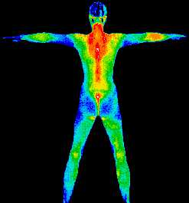
Do not all fix’d Bodies, when heated beyond a certain degree, emit Light and shine; and is not this Emission perform’d by the vibrating motion of its parts?
Isaac Newton, Opticks, published 1704.
IR Sources are “Planck Black Body Radiators”
Without thinking, which is hotter?
Red hot or white hot?
What temperature range would give us photons in the mid-IR range?
Nernst Glower: heated rare earth oxide ~1500 K
Spectra output 1-50 um
Globar: heated silicon carbide ~1500 K
Spectra output 1-50 um
Slide 12

Slide 13
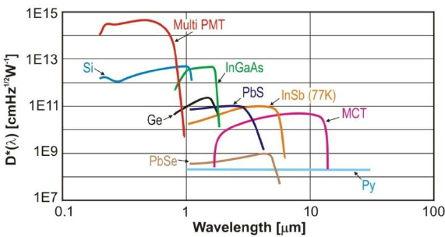
IR Detectors
Visible photons are energetic and in semi-conductors will kick electrons out of valence bands and into conduction bands, producing a current
Mercury Cadmium Telluride (MCT) is an IR photon sensitive semiconductor which must be liquid N₂ cooled
“Pyroelectric” detectors –deuterated triglycine sulfate detector (DTGS) - work based on temperature differences
D* is a measure of sensitivity
Slide 13

Slide 14
Refractive Index
The speed of light a constant 3.00 x 10⁸ m/s
Slower in denser material
➔ in a vacuum
Refractive index n = c = speed in a vacuum
v speed in media
vacuum n = 1
water n = 1.33
n₁ > n₂
n₂
θ₂
Snell’s Law
n₁ = sin θ₂
n₂ sin θ₁
θ₂
Critical Angle
n₁
θ₁
θ₁
Fiber optics
θ₁
Refractive index is related to density
Concentration | Index
10% Glucose solution in water | 1.3477
20% Glucose solution in water | 1.3635
60% Glucose solution in water | 1.4394
Slide 14

Slide 15
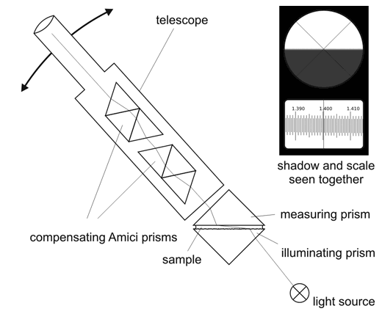
Refractometry and Instrument Design
Visible
http://www.refractometer.pl/Abbe-refractometer
Slide 15

